Slide 1
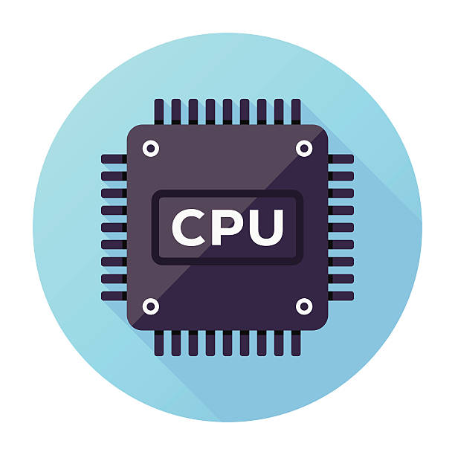
The Central Processing Unit (CPU)
For Senior Secondary School 2

Slide 2
Definition
The central processing unit (CPU) is the portion of a computer system that executes the instructions of a computer program, and is the primary element carrying out the functions of the computer or other processing device.
The central processing unit (CPU) is the computer component that’s responsible for interpreter and executing most of the commands from the computers other hardware and software.
Note:
The Central Processing Unit (CPU) is the part of a computer that thinks, calculates and carries out instruction.

Slide 3
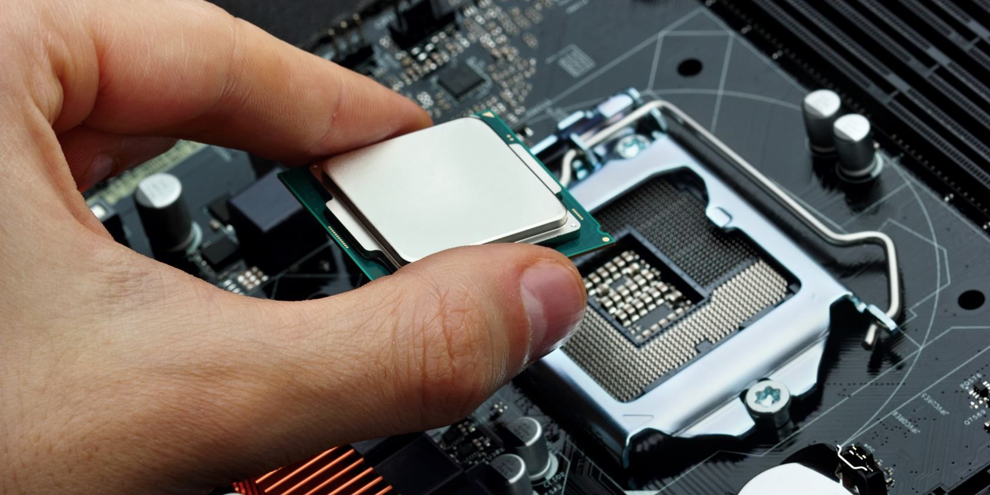
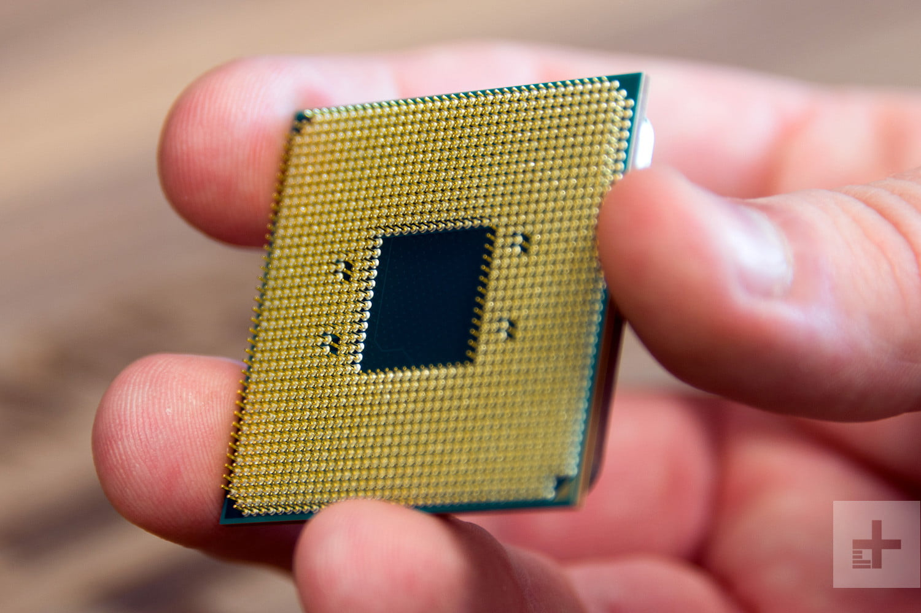

Slide 4
Note:
The Central Processing Unit carriers out each instruction of the program in sequence, performs the following:
1. Arithmetical
2. Logical
3. Input / Output Operations of the system.
The Central Processing Unit (CPU) is also called the brain of the computer. It is sometimes called the central processor or simply the processor.

Slide 5
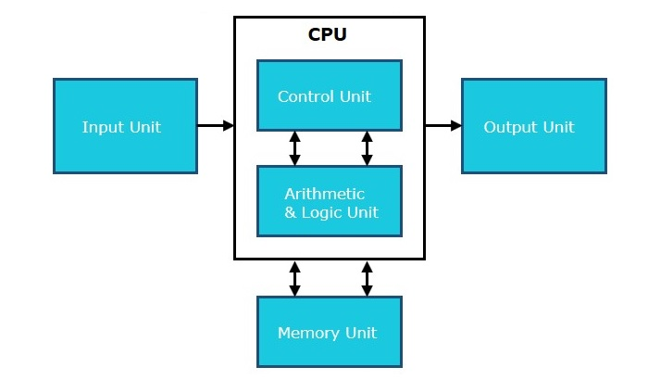

Slide 6
A computer can have more than one CPU; this is called Multiprocessing. The CPU can be found in the motherboard. All the functions of the CPU are stored in a component called the Chip.
All sorts of devices use a CPU, including:
1. desktop
2.Laptop
3.Tablet
4.Smart phones
5.Flat Television set

Slide 7
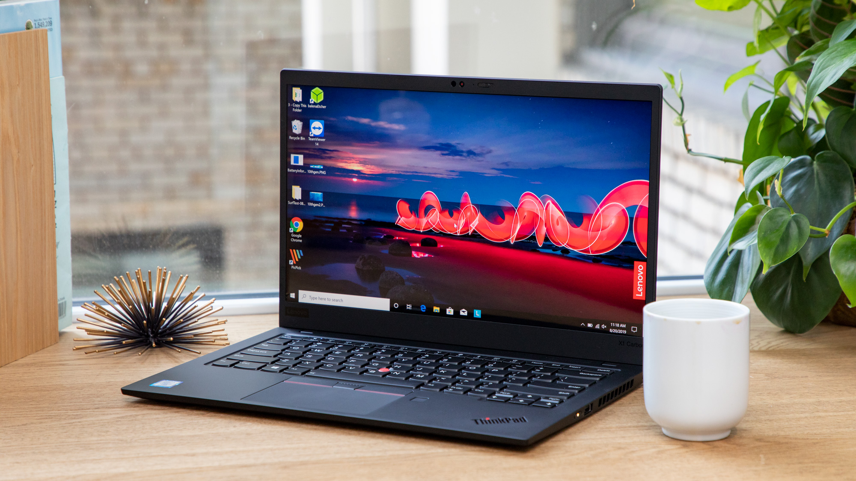





Slide 8
Intel and AMD are the two most popular CPU manufacturer for desktops, laptops and servers, while NVIDIA and Qualcomm are big smart phone and tablet CPU makers.
CPU has different names including:
1. Processor
2. Microprocessor
3. Brain of the computer

Slide 9
The CPU attaches directly to a CPU ‘Socket’ (or sometimes a ‘Slot’) on the motherboard. The CPU is inserted into the socket pin-side-down.
The Clock Speed of Processor
The Clock speed of a processor is the number of instructions it can process in any given second, measured in hertz (Hz). A CPU with a Clock Speed of 3.0 GHz can process 3 billion instructions each per second.
Some devices have a single- core process while others may have a dual-core (or quad-core, etc) processor.

